Slide 1
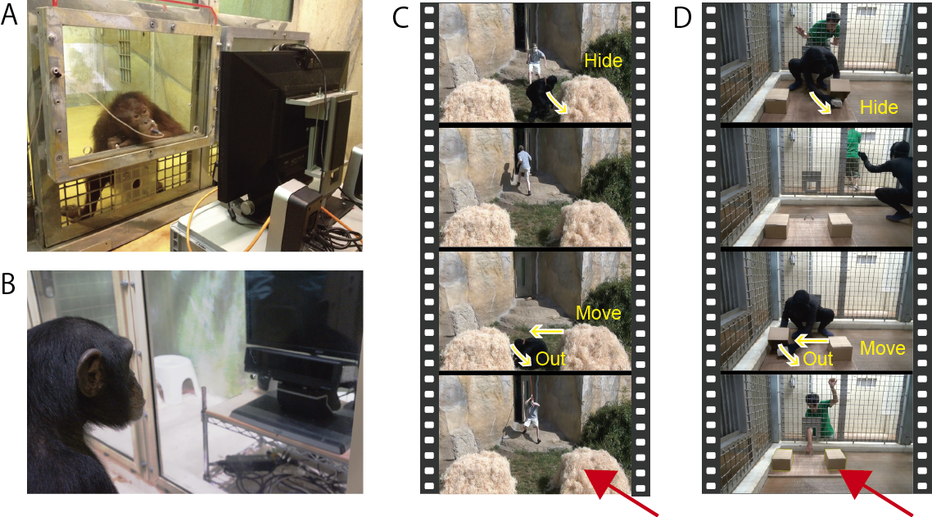
Krupenye, C., Kano, F., Hirata, S., Call, J., & Tomasello, M. (2016). Great apes anticipate that other individuals will act according to false beliefs. Science, 354(6308), 110-114.
A. Eye-tracking of an orangutan and B. a chimpanzee.
C. One scenario used in the false-belief test. The human actor chased the ape-character with a large stick. The ape character hid in one of the two haystacks and then, while the human actor was away, moved from there.
D. The other scenario used in the test. The human actor and the ape-character competed for an object. The ape character hid the object in one of two boxes and then, while the human actor was away, moved it from there while the human actor was away.
The red arrows indicate the container where the human actor falsely believed the object to be (C and D).
Conclusion: Great apes anticipate that other individuals will act according to false beliefs, as suggested by their anticipatory looks.

